Slide 1
CHAPTER 1 – COLLIDING WORLDS (1450-1600)
The Native American Experience

Slide 2
The First Americans
-13,000-3,000BC – Archaeologists suggest migration of peoples into Americas across Bering Land Bridge during Ice Age
-Western Hemisphere cut off from Eastern Hemisphere for 300 generations as ice melts, seas rise, land bridge submerges
-Migrants pushed southward, concentrating most in Central Mexico and Andes Mountains region
-6000BC – Domestication of crops – maize (corn) and potatoes; food surpluses led to large population growth

Slide 3
American Empires
Characteristics shared by both Aztec and Incan Empires: Dense populations (Mexico est. 20 million in 1500CE; Peru est. 12 million in 1500CE) Productive agriculture Aggressive bureaucratic state - king/emperor ruled over warrior-nobles System of tribute exploited from surrounding conquered peoples Practice of human sacrifice employed by priests
Aztec Empire: Capital city Tenochtitlan (pop. 250,000) Controlled fertile valleys of Mexico Strong belief that cosmos connected to their capital, and that gods needed to be appeased through human sacrifice | Incan Empire: Capital city at Cuzco (pop. 60,000) Controlled highlands & Andes Mountains to Pacific coast Intricate system of roads connected goods/tribute/labor from all regions of empire to capital

Slide 4
Chiefdoms & Confederacies
1. The Mississippi Valley
-Spread of maize by 1000CE, urban sites built up from previous Adena & Hopewell cultures
-Cahokia (pop. 10,000-30,000) displayed large-scale mound-building of varying size/purpose (tombs, ceremonial sites, elite homes)
-Urban sites abandoned around 1350CE; possibly due to regional warfare & environmental strains. Culture endured into 1500’s.

Slide 5
Chiefdoms & Confederacies
2. Eastern Woodlands
-“Great Traditions” of common language groups (Algonquin/Iroquois) linked dozens of small tribes
-Three-crop agriculture (maize/beans/squash) mixed with hunting-gathering
-Much of domestic village life/agriculture tended by women while men hunted/fished/made war
-Slash & burn (swidden) agriculture meant natives seasonally cleared forest for growing crops
-Chiefdoms – tribes ruled by powerful men, some securing loyalty/service/tribute of smaller local chiefs (ex. Powhatan)

Slide 6
Chiefdoms & Confederacies
-Lenni Lenape/Delaware tribes existed as single autonomous units whose landscape names dot the Mid-Atlantic region to this day
-Iroquois Confederacy – Political authority granted to councils of sachems (wise men) who banded together
(Five Nations = Mohawk, Oneida, Onondaga, Cayuga, & Seneca)
-Legend of Hiawatha – Spiritual leader encourages peace/trade to replace years of constant war
-Matriarchal society – Power inherited through female lineage

Slide 7
Chiefdoms & Confederacies
3. The Great Lakes
-Multitude of diverse Algonquin-speaking tribes, all mobile via canoes that allowed travel across thousands of lakes and rivers
4. Great Plains / Rocky Mountains
-Small dispersed hunter-gatherer groups, many of whom adapted to using wild horses (introduced by Spanish) to hunt wild bison
-Comanche and Sioux able to extend power over great regions, raiding for horses and trading with other tribes
-Tribes scattered across Great Basin in Rocky Mtns to hunt-gather limited resources (bison/bighorn sheep, salmon, pine nuts)

Slide 8
Chiefdoms & Confederacies
5. Arid Southwest
-Maize agriculture present in Anasazi culture circa 1 CE; followed by Pueblo peoples in canyon lands circa 600 CE
-Settlements featured irrigation to manage scare water, adobe apartment buildings, communities built on cliff slides for protection
-Chaco Canyon in New Mexico – an urban site for dozen towns; abandoned after 1150 CE due to drought & soil exhaustion
6. Pacific Coast
-California coast featured pop. 300,000 in distinct hunter-gatherer tribes spread across diverse landscapes
-Pacific coast saw tribes ruled by powerful families who encouraged warrior traditions, longhouse communal buildings, totem poles

Slide 9
Patterns of Trade
-Trade networks tied together regions that allowed food/raw materials/ritual artifacts/decorative goods to travel thousands of miles
-Trade fairs conducted between hunting & farming tribes – hides/meat for maize/pottery/textiles; exchange in war captives
-Prized regional items found across continent: copper/mica/obsidian/seashells/grizzly bear claws/eagle feathers
-Powerful tribal leaders hoarded the most wealth, but shared it with tribal subordinates & families; showed sign of good leadership

Slide 10
Sacred Power
-Animism – natural world suffused with spiritual power; world understood through dreams/visions; rituals appeased guardian spirits
-Female spirituality tied to fertility and connection to Mother Earth; male spirituality tied to hunting prowess and war
-War had varied purposes, such as gaining territory, rite of passage for young men, feud between tribes, revenge for taking captives

Slide 11
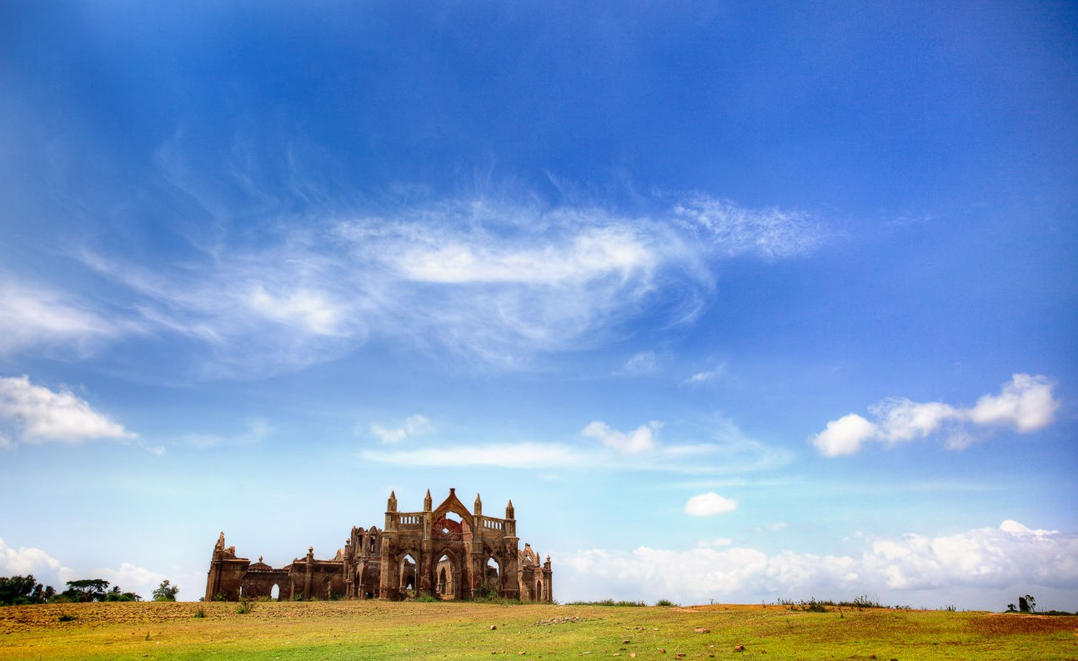
CHAPTER 1 – COLLIDING WORLDS (1450-1600)
Western Europe

Slide 12
Hierarchy & Authority
-Hierarchical society – power from above, as kings/princes ruled vast tracts of land, commanded armies, lived off peasant labor
-Nobility often challenged royal authority, or competed to succeed it. Nobles sometimes organized (parlements, House of Lords)
-Patriarchal society – Power inherited through male lineage; men controlled wives and children
-Primogeniture – Practice of bestowing all family wealth/goods on eldest son (leaving other siblings poor; lacking personal freedom)

Slide 13
Peasant Society
-Most of Europe were peasants – farmworkers of cooperative families who lived in small villages surrounded by fields
-Manor system – regional lord ruled peasants as serfs, tied to the land via oath of labor for access to portion of crops
-Rent-pay and family landownership led to food surpluses and local market economies
-Seasonal lifestyle meant constant labor; poverty conditions generally harsh as half of all peasant children died before age 21

Slide 14
Expanding Trade Networks
-Western Europe experienced fragmentation while Arab world preserved achievements of Greek & Roman and Mediterranean merchants carried on trade.
-New contacts with Asia for spices, silk, and exotic goods and sailing technology creates opportunities.
-1100’s CE – Italian city-states (republics ruled by oligarchies of wealthy merchant families) included Pisa, Genoa, Florence, & Venice
-Venice commanded fleet of 3,000 ships, establishing profitable commerce between merchants, bankers, and manufacturers

Slide 15
Expanding Trade Networks
-Civic humanism – ideology that praised public virtue and service to the state
-City-states promoted patronage of arts (Michelangelo, Leonardo da Vinci) & learning that laid foundations for Europe’s Renaissance
-Hanseatic League – coalition of trading cities in Northern Europe that facilitated trade in wool, textiles, timber, furs, grains, honey
-Monarchs of Western Europe began to consolidate/centralize power through bureaucracy/taxes/alliances with merchants/nobility
-Guilds – merchant/craftsmen organizations that regulated trade, set wages and prices, and protected business

Slide 16
Myths, Religions, & Holy Warriors
1. The Rise of Christianity
-Christianity – monotheistic religion derived from Judaism that suggested Jesus Christ was both prophet & savior to followers of God
-312 CE – Emperor Constantine converts to and makes Christianity the central belief system of Roman Empire
-After fall of empire, Roman Catholic Church becomes unifying force across feudal Europe:
* Hierarchy headed by Pope who controlled cardinals, bishops, and priests
* Latin language preserved as common instrument of scholarship/theology
* Animist traditions converted into Christian rituals & festivals, as peasant life
conforms to Church teachings about salvation
* Heresy – practices seen as oppositional to Church teachings and given over to the
influence of sin and of Satan (Devil)

Slide 17
Myths, Religions, & Holy Warriors
2. The Crusades
-632 CE – death of prophet Muhammad sees monotheistic religion of Islam spread from Arabia throughout Africa & Middle East
-1096-1291 CE – Holy war crusades undertaken by Christian armies (directed by Pope) to conquer Jerusalem and Holy Land
-Crusades failed militarily, but…
*inspired Christian unity in Europe
*increased persecution of Jews/Muslims
*increased access to Asian trade goods
*initiated rediscovery of Greek/Roman knowledge through contact with Arab scholars
*and promoted exposure to wider world beyond Europe

Slide 18
Myths, Religions, & Holy Warriors
3. The Reformation
-1517 CE – Martin Luther nails 95 Theses to doors of church in Germany, protesting corruption & abuses of Catholic Church, downplaying need for priests and promoting need to read the Bible, and translating Holy Book into vernacular (local languages)
-1536 CE – John Calvin promotes predestination - concept of omnipotent God who chooses people for salvation; condemns the rest
-Protestant Reformation – movement of radical reformers whose ideologies spread throughout Europe in opposition to Catholicism
-Counter-Reformation – Catholic Church wages war against Protestants but also reforms practices; creates Jesuit monastic order
-Europe’s religious competition spreads to New World (Catholic nations to gain new souls; Protestant nations to create godly communities of true gospel of Christianity)

Slide 19
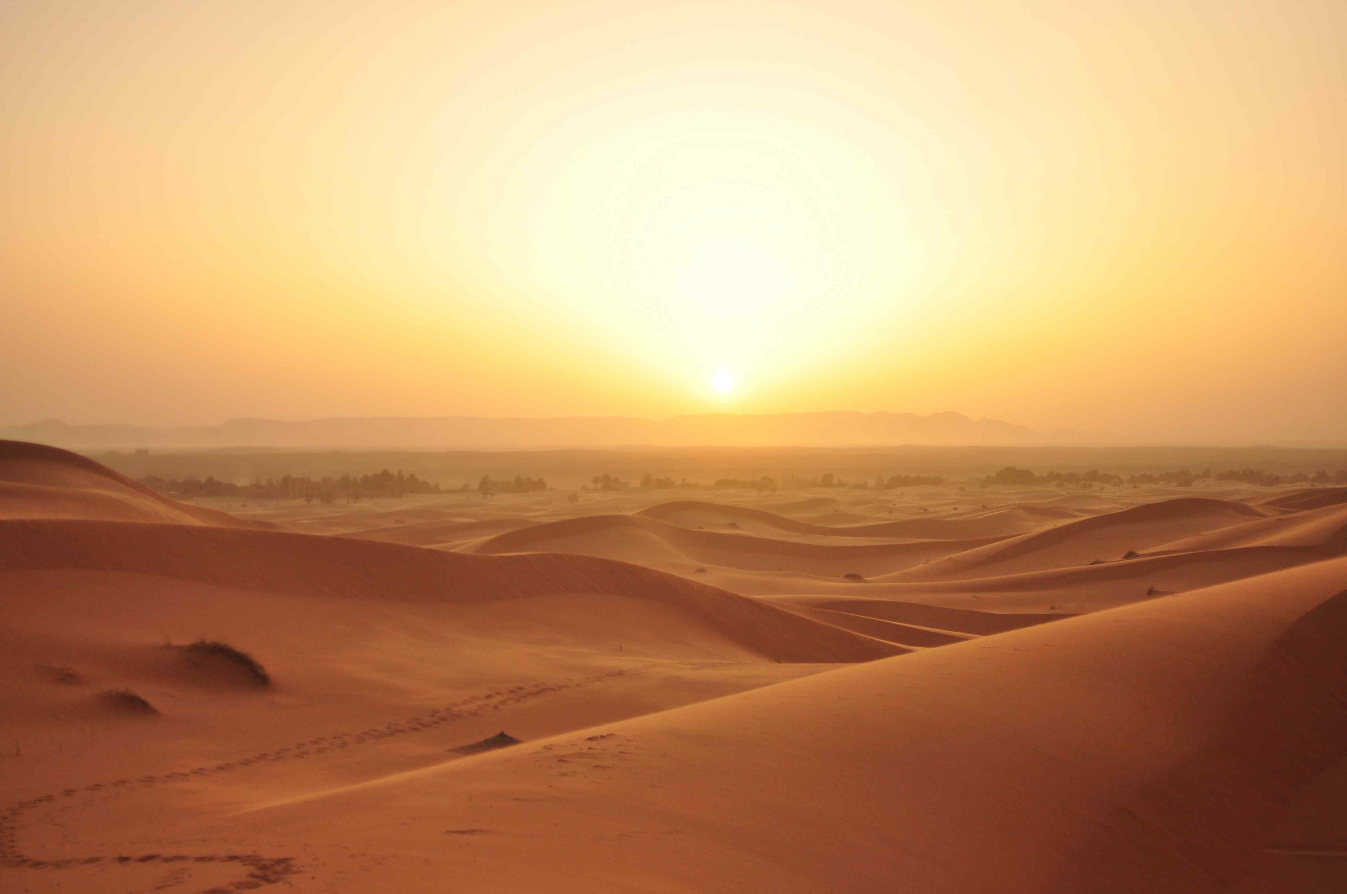
CHAPTER 1 – COLLIDING WORLDS (1450-1600)
Western & Central Africa

Slide 20
Empires, Kingdoms, & Mini-States
-West Africa home to three climate zones: Sahel (flat plains), savannah (grasslands), & tropical rainforest; 4 major river watersheds
-Sudanic peoples spread across West Africa (9000-1000 BC) bringing domesticated cattle, crops, pottery, cotton, & metalworking
-Three empires established military might to protect trade routes:
* Ghana (c. 800 CE) – pioneered trans-Saharan camel routes; exported gold
* Mali (1200’s CE) – Muslim influenced kingdom who spread gold to North Africa, Europe, and Asia; capital city of Timbuktu
* Songhai (1400’s CE) – eclipsed Mali; controlled smaller vassal kingdoms that became exposed to European contact
-Sub-Saharan Africa populated by small tribes/mini-states that traded and competed for local power & resources

Slide 21
Trans-Saharan & Coastal Trade
-Trans-Saharan route saw West African goods (gold, copper, and slaves) traded for textiles & foreign goods
-Europeans sailed down West African coast to trade with mini-states; regions nicknamed Ivory Coast, Gold Coast, Slave Coast
-Kingdom of Kongo the largest state in Central Africa (capital city boasted pop. 100,000)

Slide 22
The Spirit World
-Numerous sub-Saharan states adopted Islam, while traditional beliefs in animism, polytheism, and belief in divine kingship persisted
-Reverence for ancestors a “great tradition” across many societies; happiness meant large families, many wives/children, even slaves

